Slide 1
Extending Kubernetes API
API Server, custom API and custom resources

Slide 2

Overview
Part 1
Part 2
Intro into API Server (core API and structure), discovery
Extending the API Server with a custom API
Accessing the API Server via client libraries
Metrics server overview
Custom Resource Definitions (CRDs)
CRD controllers
Kubernetes operator library
Using Helm

Slide 3
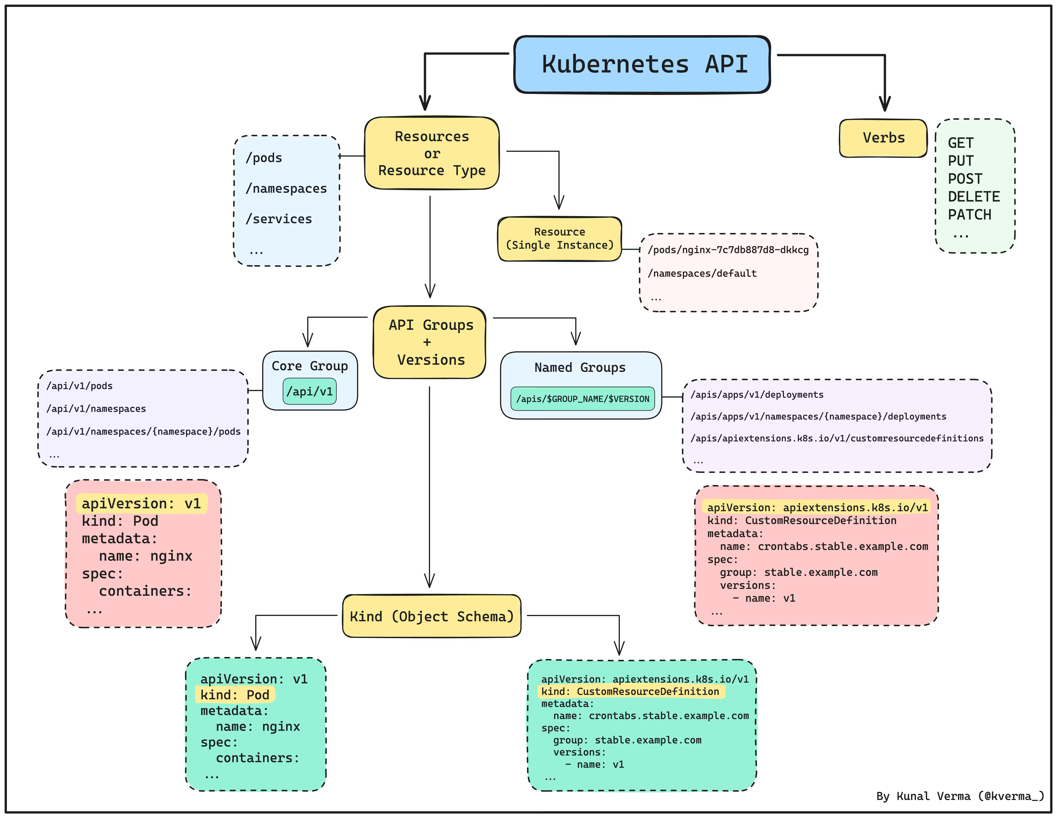
Kubernetes API structure

Slide 4
Custom resource definition
A type of resource that allows to add custom resources known to
Kubernetes
CRD manifest + controller = operator

Slide 5
CRD vs APIService
API endpoints are added automatically.
An endpoint URL is not important

Slide 6
CRD use case
Extend/encapsulate resource management logic
Create a custom workflow

Slide 7
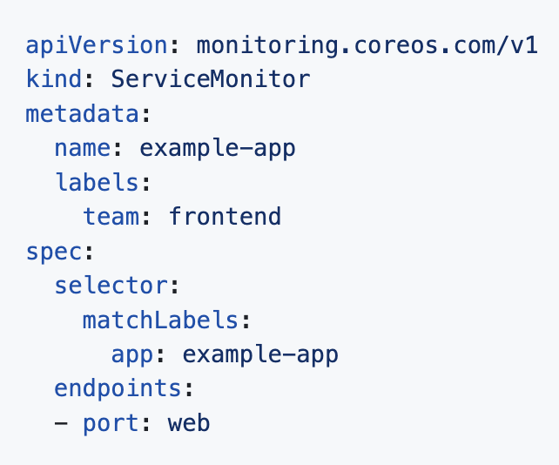
CRD use case: Prometheus operator
…
scrape_configs:
# Scrape Prometheus itself
- job_name: 'prometheus'
static_configs:
- targets: ['localhost:9090’]
- job_name: 'static-targets'
static_configs:
- targets: ['192.168.1.1:9100', '192.168.1.2:9100']
labels:
environment: 'production'
group: 'servers'
# Example of scraping dynamic targets using DNS service discovery
- job_name: 'dns-sd-targets'
dns_sd_configs:
- names:
- 'tasks.example.com'
type: 'A'
port: 9100
refresh_interval: 30s
…

Slide 8
CRD example
apiVersion: apiextensions.k8s.io/v1 kind: CustomResourceDefinition metadata: # name must match <plural>.<group> name: ephemeralvolumeclaims.crd.dev spec: scope: Namespaced group: crd.dev names: kind: EphemeralVolumeClaim plural: ephemeralvolumeclaims singular: ephemeralvolumeclaim shortNames: - evcs - evc versions: - name: v1 served: true storage: true schema: openAPIV3Schema: type: object properties: spec: type: object x-kubernetes-preserve-unknown-fields: true status: type: object x-kubernetes-preserve-unknown-fields: true

Slide 9
CRD example
apiVersion: apiextensions.k8s.io/v1 kind: CustomResourceDefinition metadata: # name must match <plural>.<group> name: ephemeralvolumeclaims.crd.dev spec: scope: Namespaced group: crd.dev names: kind: EphemeralVolumeClaim plural: ephemeralvolumeclaims singular: ephemeralvolumeclaim shortNames: - evcs - evc versions: - name: v1 served: true storage: true schema: openAPIV3Schema: type: object properties: spec: type: object x-kubernetes-preserve-unknown-fields: true status: type: object x-kubernetes-preserve-unknown-fields: true

Slide 10
CRD controller implementation options
Implementation from scratch
KOPF python library

Slide 11
KOPF library vs implementation from scratch
Advantages of KOPF:
- Abstracts away boilerplate (event types, run in a thread) - Automatic Retry on error - connect the custom resource to a child resource with one line - built-in ability to filter on fields, annotations

Slide 12
KOPF library vs implementation from scratch
Advantages of KOPF:
- Abstracts away boilerplate (event types, run in a thread) - Automatic Retry on error - connect the custom resource to a child resource with one line - built-in ability to filter on fields, annotations

Slide 13
When to use CRD or APIService
CRD
APIService
Simpler to implement
Native management (e.g. kubectl get <cr name>)
Custom workflows based on resource manipulation
Performance
Complex endpoints (e.g. query params)
Custom authentication

Slide 14
Other
Webhooks
Open Service Broker API

Slide 15
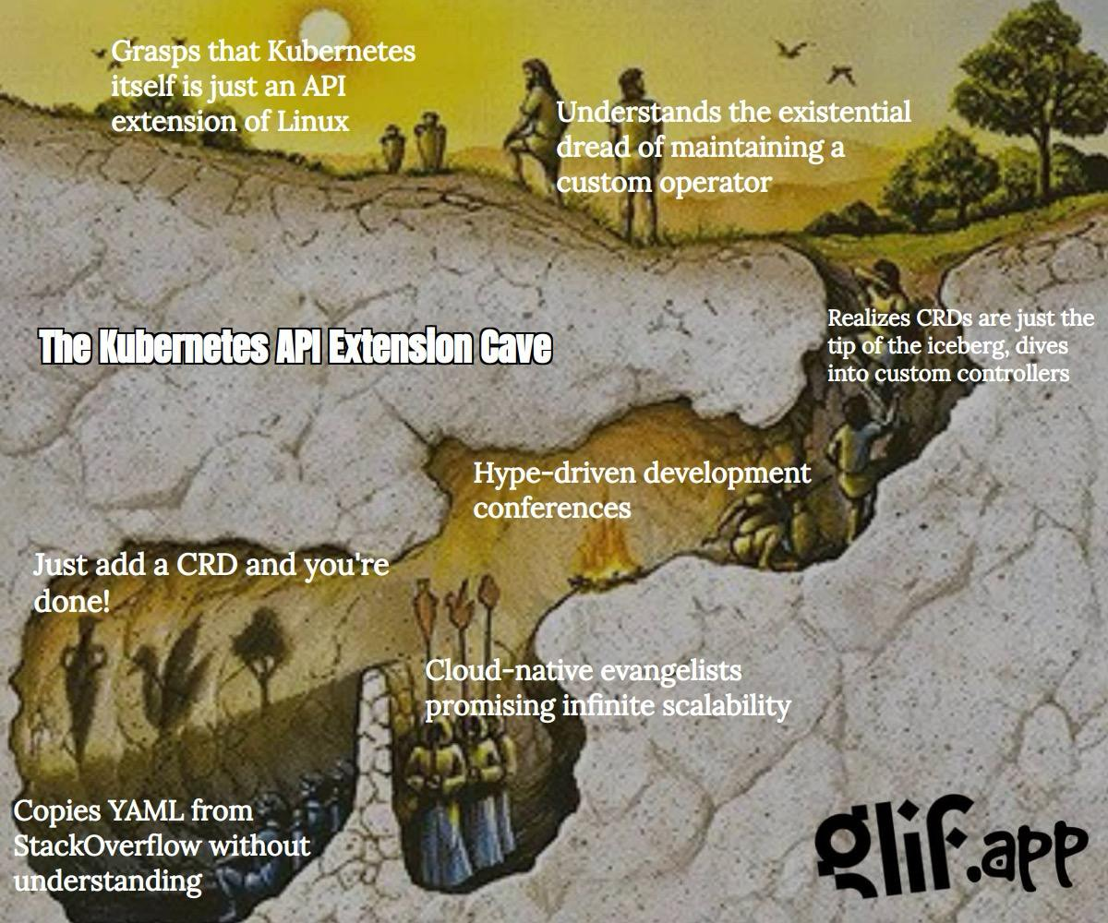
Fine art

Slide 16
Organizing Kubernetes manifests
Share, version, revert collections of manifests?

Slide 17
Helm
A “package manager” for Kubernetes
Allows to package and deploy applications in Kubernetes

Slide 18
Helm chart
A structured collection of files.
A running instance = release.

Slide 19
Helm chart features
Track changes via versions
View release history
Rollback a release
“Docker image” a chart
Share via a remote repo
Add dependencies

Slide 20
Helm chart features
Track changes via versions
View release history
Rollback a release
“Docker image” a chart
Share via a remote repo
Add dependencies

Slide 21
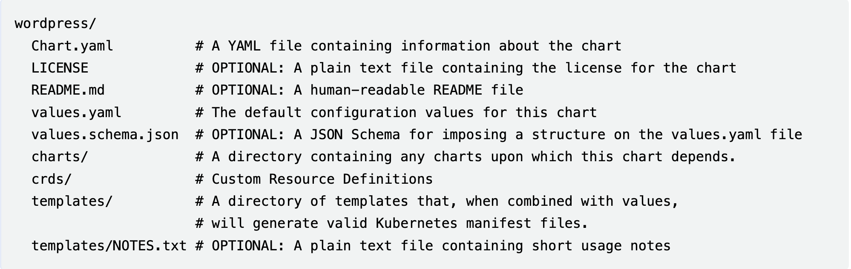
Helm chart structure
https://helm.sh/docs/topics/charts/

Slide 22
Helm: wait for resources
--wait
--wait-for-jobs
post-install hook
crds folder
Separate charts with a post-install hook

Slide 23
Next steps
https://github.com/ybaryshnikova/extensions-meetup/tree/master/crd-example
https://github.com/ybaryshnikova/extensions-meetup/tree/master/helm-packaging

Slide 24
References: CRD
CRD official documentation
Python operator tutorial
Python operator tutorial repo
Kopf documentation

Slide 25
References: Helm
Helm tutorial
Chart hooks
Helm best practices
Installing CRD documentation

Slide 26
Questions?

